Slide 1

Implementation Plan for Information Security Standard
Waquis Pvt Ltd,
106/4, Bothejue Business Park,
Dutugamunu Street, Kohuwela,
Dehiwela.

Slide 2
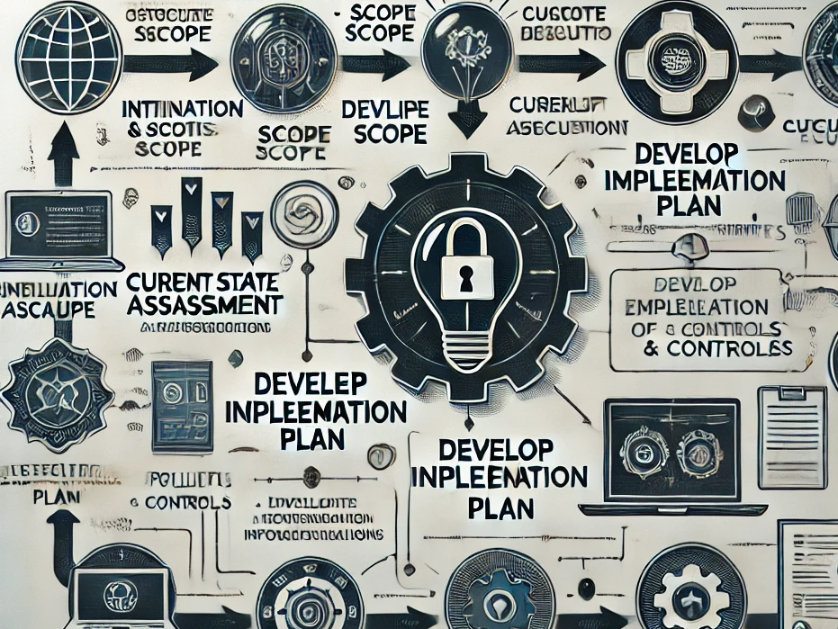
Overview of the Implementation Process
• Step 1: Initiation and Scope Definition
- Define the objectives and scope of the information security program
• Step 2: Current State Assessment
- Evaluate existing security measures and identify gaps
• Step 3: Develop Implementation Plan
- Outline the specific actions, timelines, and responsibilities
• Step 4: Execution of the Plan
- Implement policies, procedures, and controls
• Step 5: Monitor and Review
- Continuous monitoring and evaluation of security measures

Slide 3

Steps for Asset Inventory and Risk Assessment
• Step 1: Identify Assets
- Catalog all information assets (hardware, software, data)
• Step 2: Assess Value
- Determine the criticality and value of each asset
• Step 3: Identify Threats and Vulnerabilities
- Evaluate potential threats and vulnerabilities associated with each asset
• Step 4: Analyze Risks
- Calculate risk levels based on likelihood and impact
• Step 5: Document Findings
- Prepare a comprehensive risk assessment report

Slide 4
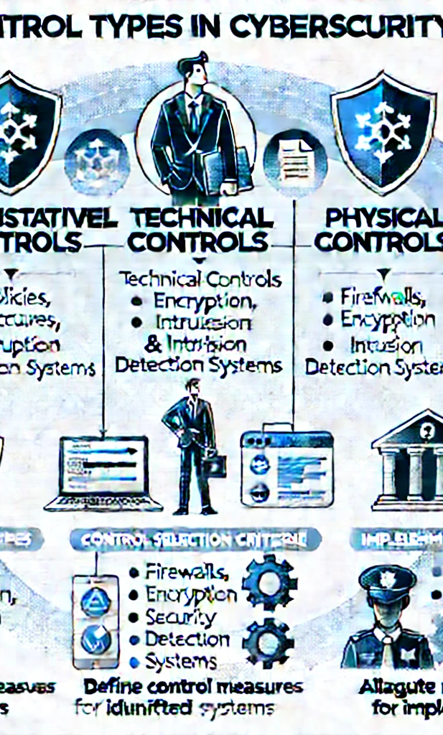
Security Control Planning
• Control Types:
- Administrative Controls: Policies, procedures, and training
- Technical Controls: Firewalls, encryption, intrusion detection systems
- Physical Controls: Security guards, access control systems
• Control Selection Criteria:
- Risk levels, regulatory requirements, and industry best practices
• Implementation Steps:
- Define control measures for identified risks
- Allocate resources for implementation

Slide 5
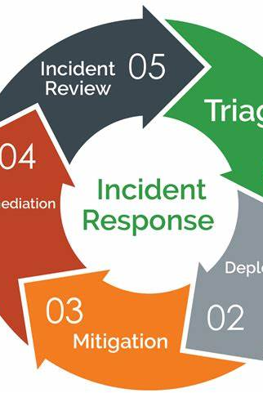
Continuous Monitoring and Incident Management
• Monitoring Strategies:
- Use of security information and event management (SIEM) tools
- Regular security audits and vulnerability assessments
• Incident Response Plan:
- Prepare a structured incident response plan
- Define roles and responsibilities during an incident
• Incident Reporting Process:
- Establish a clear process for reporting security incidents

Slide 6

Importance of Training and Awareness
• Training Objectives:
- Increase employee awareness of information security policies
- Educate employees about potential threats (phishing, social engineering, etc.)
• Training Programs:
- Regular training sessions and workshops
- Online courses and certifications
• Awareness Campaigns:
- Use posters, newsletters, and internal communications to promote awareness

Slide 7

Ensuring Documentation and Continuous Improvement
• Documentation Requirements:
- Maintain comprehensive documentation of policies, procedures, and controls
• Auditing:
- Conduct regular internal and external audits to ensure compliance
• Continuous Improvement:
- Regularly review and update policies based on new threats and changes in the environment
- Solicit feedback from employees and stakeholders

